Slide 1
2018-01-15

Slide 2
Paper Report
Logistic Regression Model Training based on the Approximate Homomorphic Encryption
Andrey Kim, Yongsoo Song, Miran Kim, Keewoo Lee, and Jung Hee Cheon

Slide 3
WHY THIS PAPER …
Our method shows a state-of-the-art performance of homomorphic encryption system in a real-world application.
The submission based on this work was selected as the best solution of Track 3 at iDASH privacy and security competition 2017.
For example, it took about six minutes to obtain a logistic regression model given the dataset consisting of 1579 samples, each of which has 18 features with a binary outcome variable.

Slide 4
Related Work
IDASH2017里面的makefile文件命令比较复杂，可能部分是由Eclipse IDE生成的。
IDASH2017: Ubuntu + Eclipse CDT + Makefile Project
配置 Win10 + Ubuntu Eclipse CDT Makefile Project
2017 iDASH
学习 Eclipse CDT 构建 C++ Project（Makefile Project）
Xuexi
Xuexi
xuexi
2018 iDASH

Slide 5
IDASH2017里面的makefile文件命令比较复杂，可能部分是由Eclipse IDE生成的。
IDASH2017: Ubuntu + Eclipse CDT + Makefile Project
配置 Win10 + Ubuntu Eclipse CDT Makefile Project
2017 iDASH
学习 Eclipse CDT 构建 C++ Project（Makefile Project）
Xuexi
Xuexi
xuexi
2018 iDASH

Slide 6
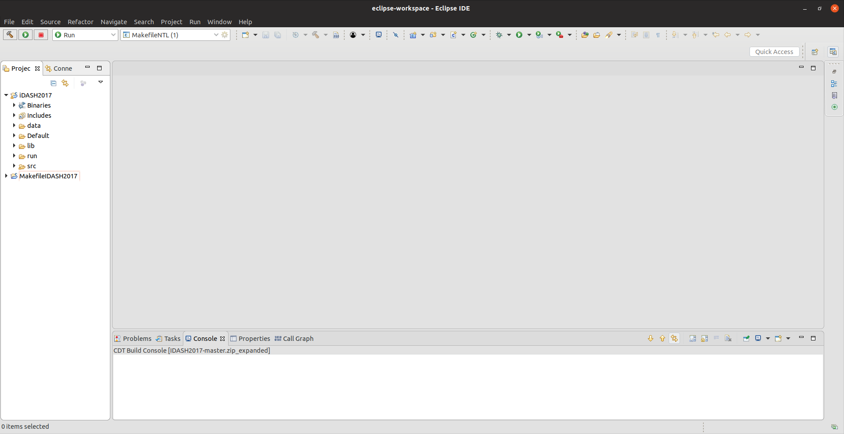

Slide 7
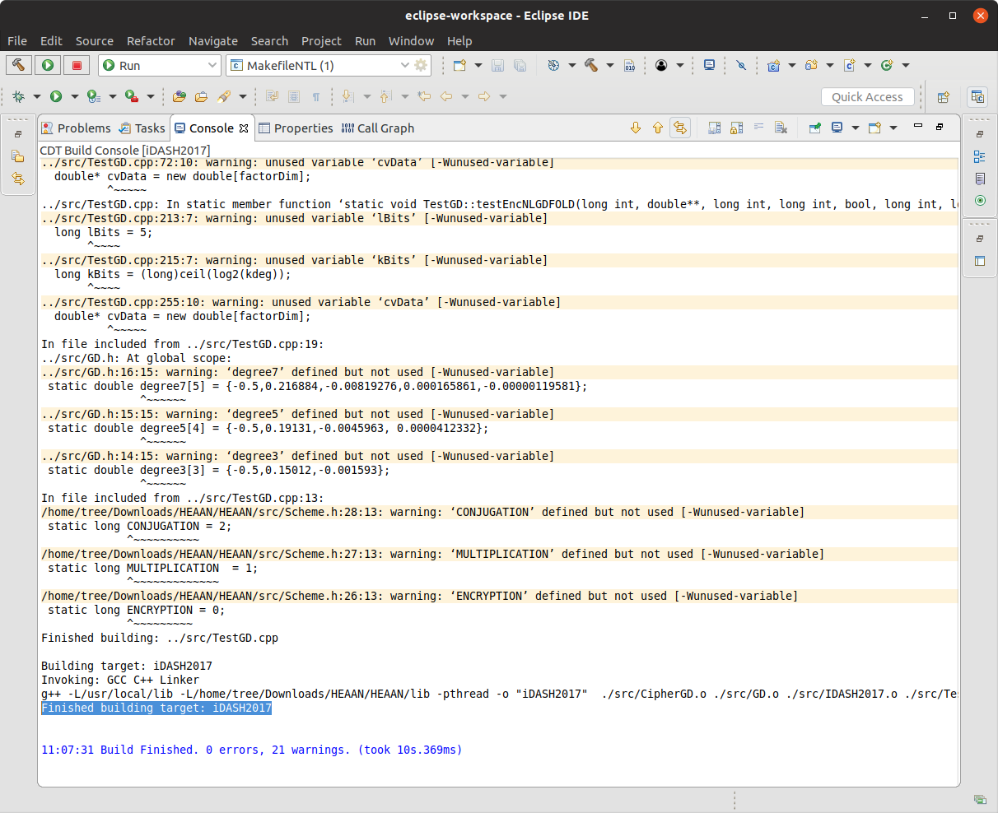

Slide 8
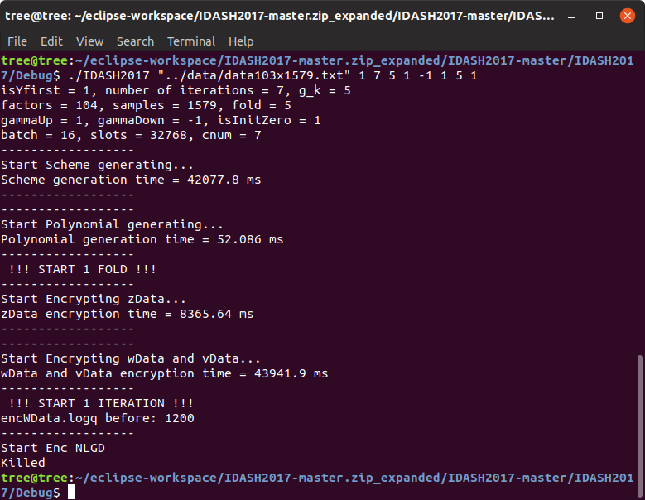

Slide 9
IDASH2017
本地 Ubuntu Eclipse CDT
服务器 CentOS 没有desktop 配置IDASH2017
打算这周先写一下关于HEAAN的文档

